Slide 1
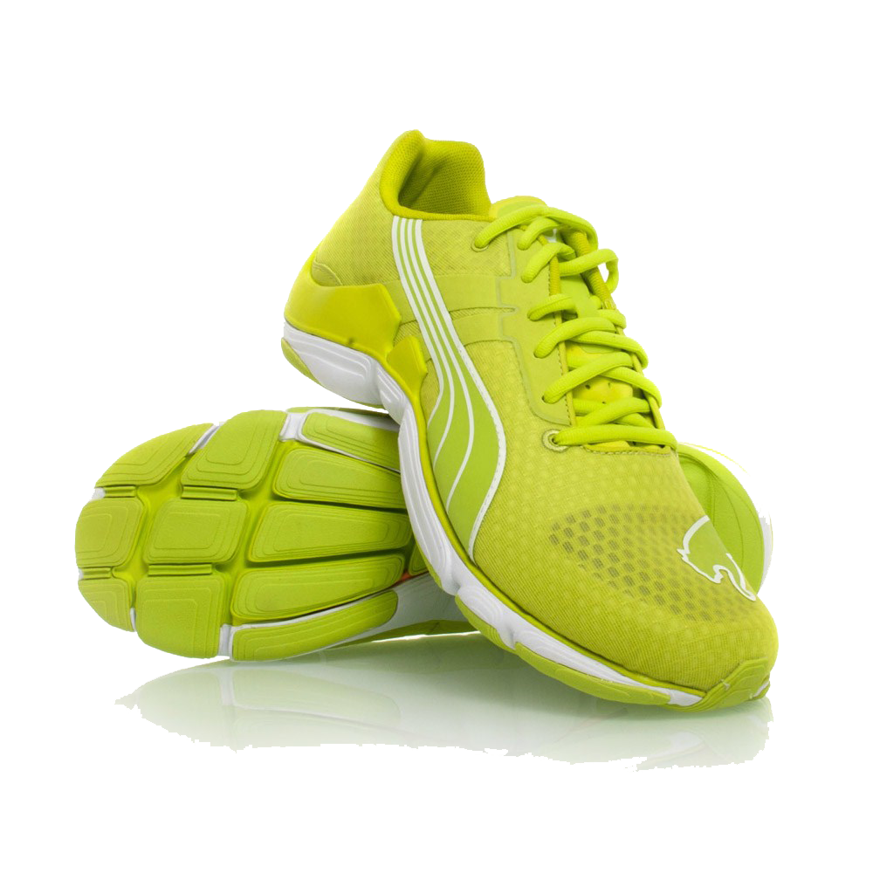
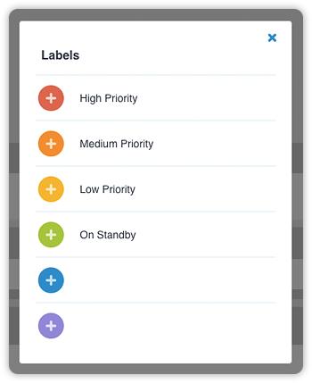

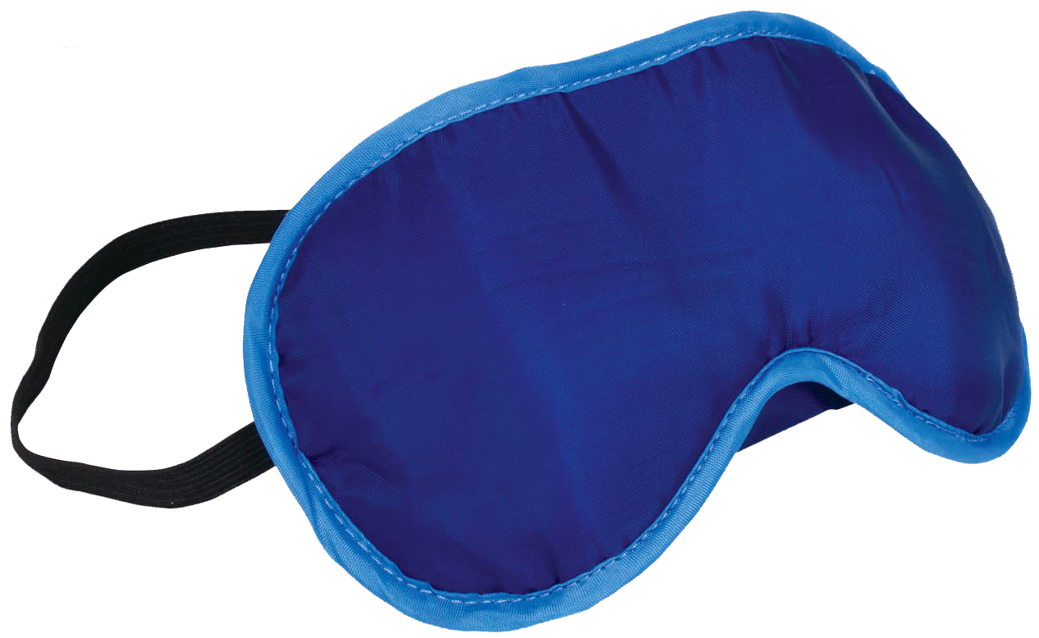
How do I stay healthy?
Stay connected with friends & family
Try to be active for 150
minutes a week
Make a schedule and TO DO lists to stay organized
Make your health a priority
Get involved in activities you enjoy
Make time
for fun and relaxation
Prioritize quality sleep most nights
Eat fruits & veggies every day
Be kind to yourself;
excellence does not require perfection
Notes:
Suggested timeline for using this slide: throughout September and January
This slide has been developed by Student Wellness Services here at Queen’s to remind you to focus on staying healthy and to take care of yourselves.
Get into healthy habits early in the term!
Sleeping, eating well, exercising, talking about your worries and even laughing can help you manage stress.
If you have any questions or want more information, google Queen’s and “health promotion”.

Slide 2
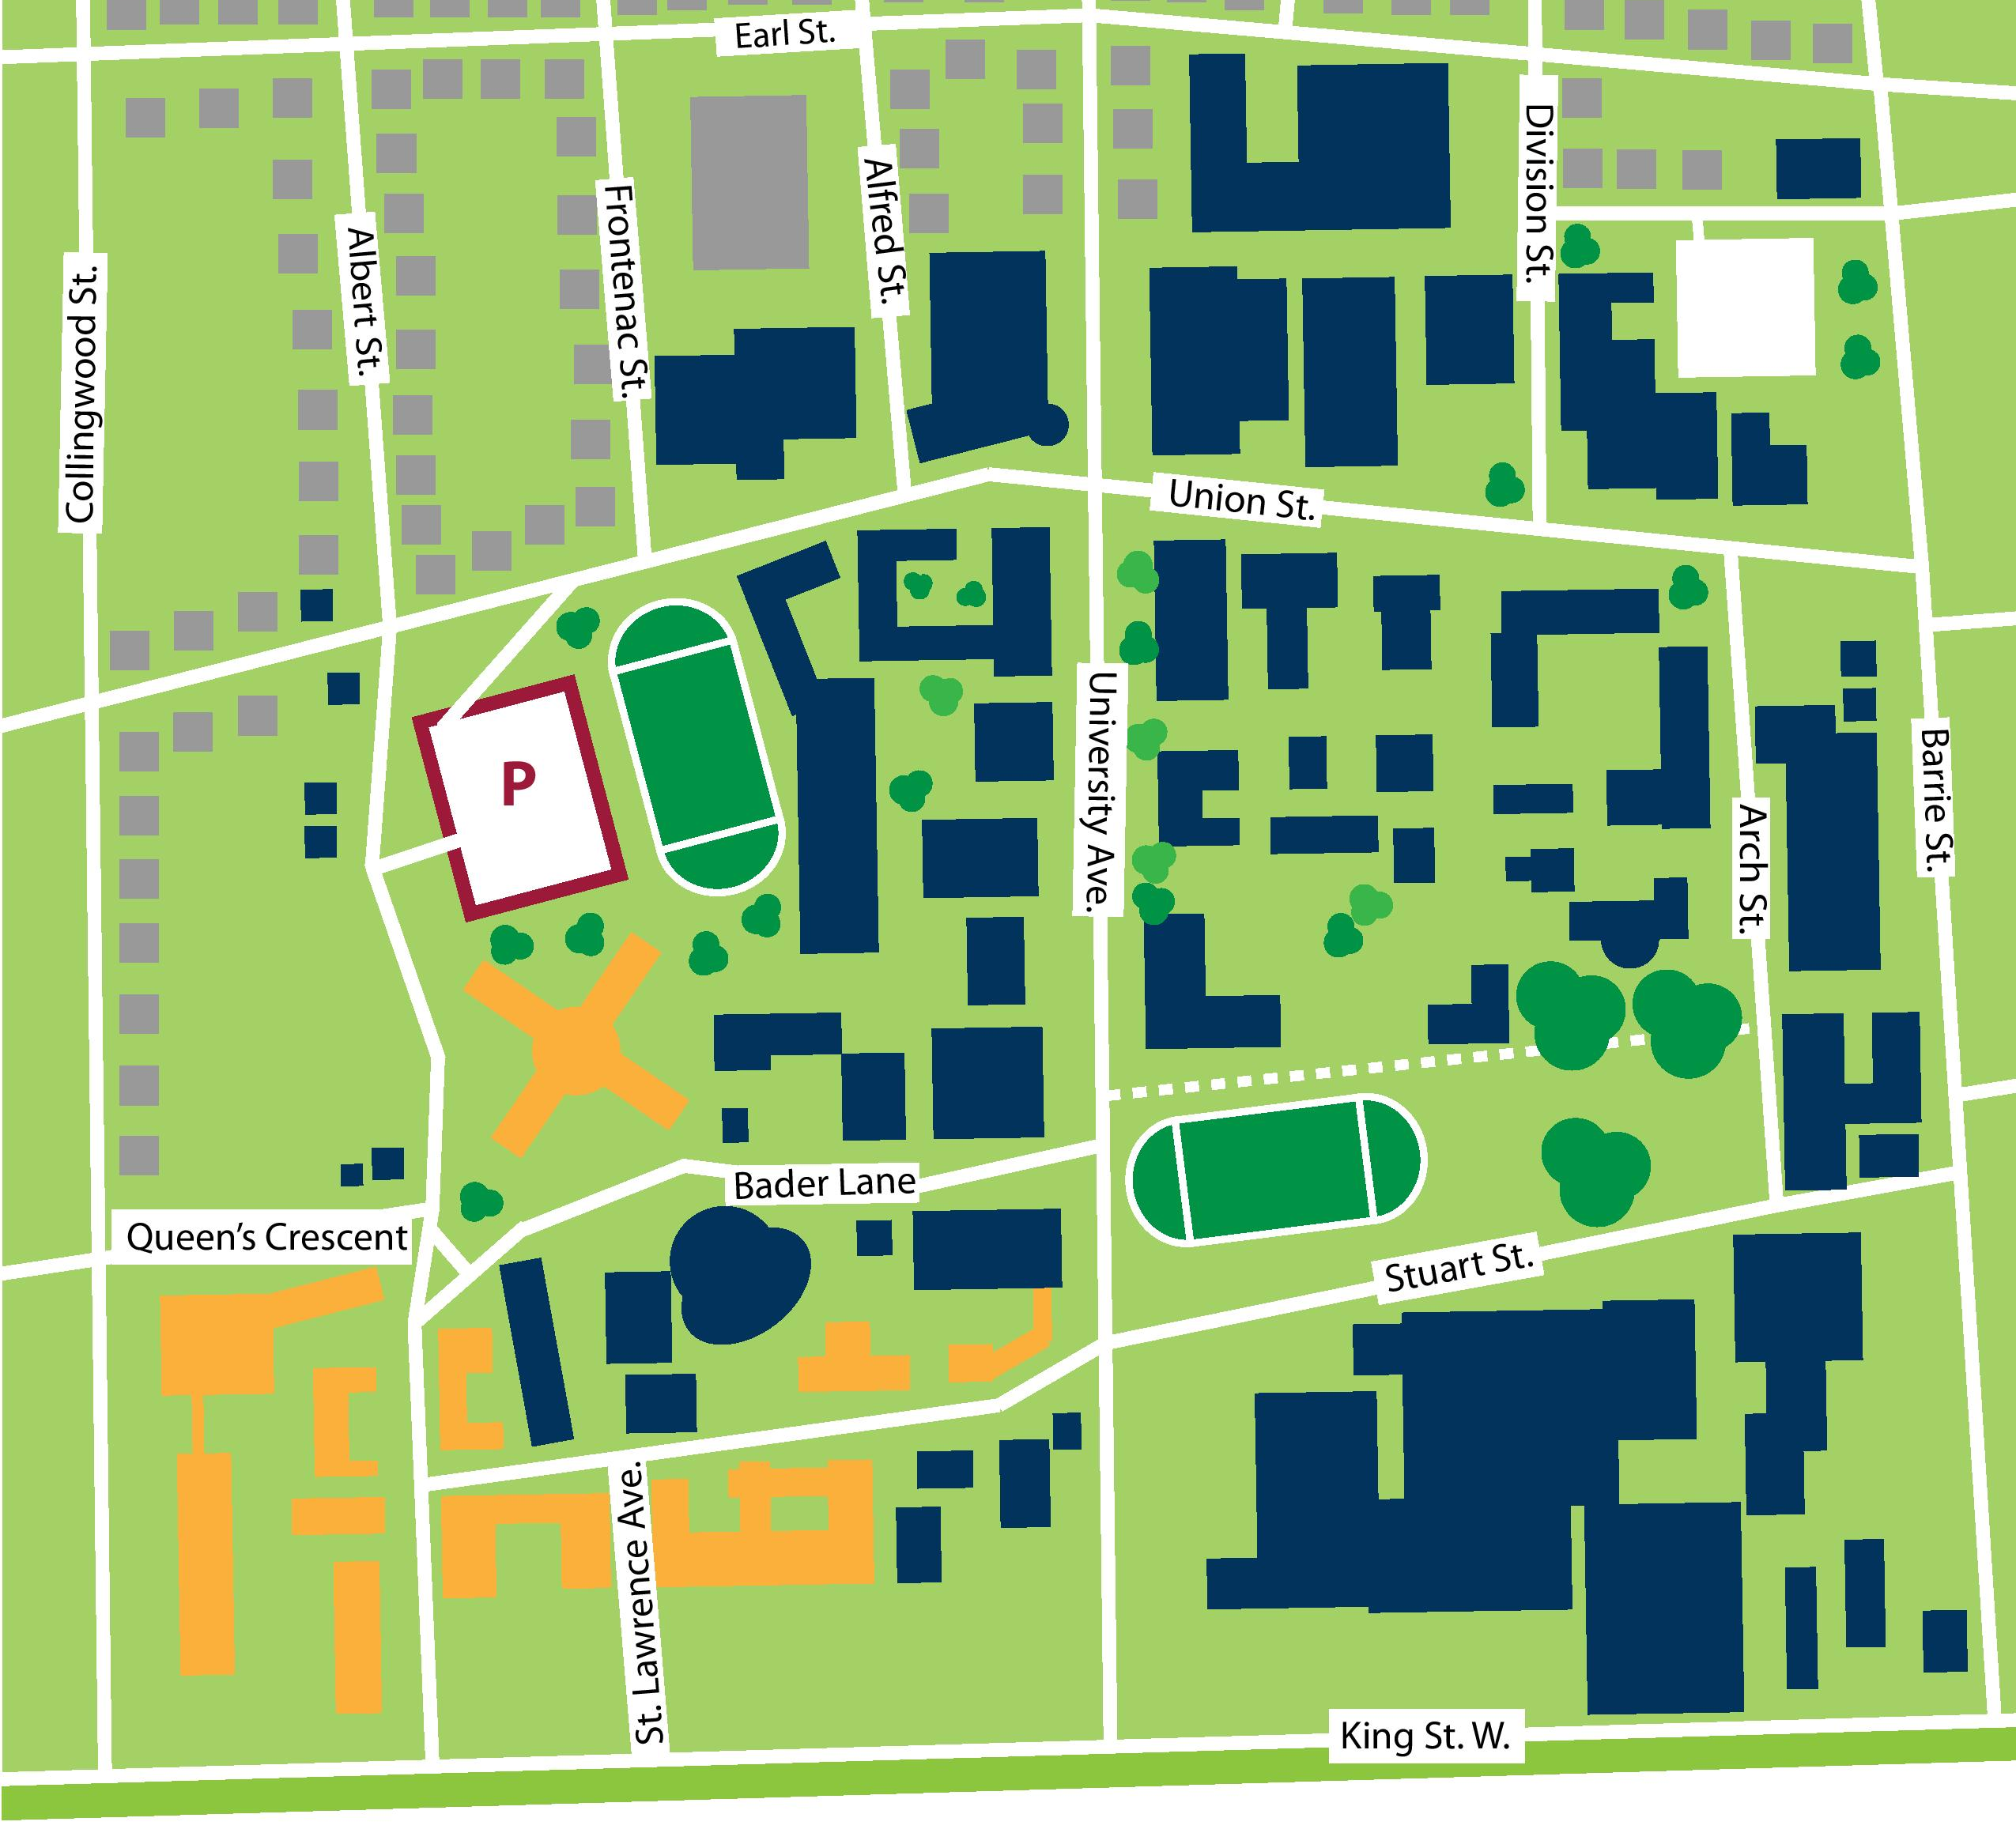
Where to get support
AMS Peer Support Centre,
John Deutsch
University Centre (JDUC),
Room 034 (lower level)
Four Directions Indigenous Student Centre,
146 Barrie Street
Student Academic Success Services (SASS),
Stauffer Library, 1st floor
Mitchell Hall
69 Union Street
Student Wellness Services
First level
Faith & Spiritual Life
Suite 210
International Centre (QUIC)
Second level
Barb Lotan
Sexual Violence,
McCorry Hall B502
Career Services,
Gordon Hall,
2nd floor
Notes:
Suggested timeline for using this slide: with Slides 1 and 2 at the start of the year to give an idea of some of the resources available on campus
This slide has been developed by Student Wellness Services to remind you all of some of the on-campus supports that you should check in with if you need some support, whether it’s academic help, career related or personal.
Don’t hesitate to reach out if you need to.

Slide 3
Feeling Overwhelmed?
Re-focus on Health
Make taking care of yourself a priority.
Talk About It
Reach out to family, friends and/or other supports.
Take Action
Look for what may be the source of stress. Make a change. Ask for help.
Use Campus Supports
- Student Wellness Services (SWS)
- Student Academic Success Services (SASS)
- AMS Peer Support Centre (PSC)
- Peer Mentoring Programs
- Office of Faith & Spiritual Life
- Academic Advisors
- International Centre (QUIC)
- Four Directions Indigenous Student Centre
Additional Mental Health Support
- Therapy Assistance Online (www.taoconnect.org)
- 24 hr community crisis line (613-544-4229)
- Good 2 Talk (1-866-925-5454)
- Big White Wall (bigwhitewall.ca)
- Bounce Back™ (Ontario.cmha.ca)
Notes:
This slide can be used when exams and assignments start around mid October and mid February.
It reminds the students to take care of themselves, seek help as needed and provides some resources available to them.

Slide 4
Worried about a Friend?
Have they stop hanging out with friends and doing things you know they like to do?
Has their weight changed dramatically (gain or loss)?
Are they are sleeping way too much or too little?
Are they having trouble making decisions or concentrating?
Does your friend need help?
Are they are making decisions that are risky or unsafe?
Are they expressing feelings of hopeless, helpless and/or worthless?
Are they are often sad, anxious, angry, irritable, or numb?
Have they stopped going to class or handing in assignments?
How to Help:
Approach, Listen, Support and
Refer them to resources
Notes:
Suggested timeline for using this slide: throughout November and March
This is a particularly stressful time of year.
This slide has been developed by Student Wellness Services to help make sure you that you all know what to do if you notice that a friend may be in trouble or if you are experiencing issues relating to stress.
Supports are available to support you and your peers. Don’t hesitate to ask for help or refer a friend.
You may also want to slide 3 with the campus map and resources at the same time.

Slide 5
How to Help a Friend
Approach
Reach out
Avoid assumptions, “diagnosis” or labels
Say what you see
Listen
Active listening
Don’t listen to fix/judge/correct or speak
Hold off on personal judgments
Support
Focus on reassurance – things can get better
Show that you’re there and want to help
Offer compassion
Refer
Treat seeking help as sign of strength/
courage
Your advice may be ignored – respect this unless it’s an emergency
“I noticed that _________, and I
wanted to see if you’re okay/you need anything/if you want to talk. I’m worried about you.”
“That sounds difficult to deal with”
“It sounds like you’re feeling…”
“You are not alone”
“Thank you for sharing this with me”
“Have you thought about seeking additional support?”
“I know some resources that may help”
Notes:
Suggested timeline for using this slide: throughout November and March
This is a particularly stressful time of year.
This slide has been developed by Student Wellness Services to help make sure you that you all know what to do if you notice that a friend may be in trouble or if you are experiencing issues relating to stress.
Supports are available to support you and your peers. Don’t hesitate to ask for help or refer a friend.
You may also want to slide 3 with the campus map and resources at the same time.

Slide 6
Sexual Violence Prevention and Response
GETTING HELP or GIVING HELP
For information about:
Understanding options
Supports and Accommodations
Changes to the Sexual Violence Policy and employee duty (excluding health care providers) to notify the SVPRC
Connecting with community resources
Visit:
queensu.ca/sexualviolencesupport/ OR
Connect:
Barb Lotan, Sexual Violence Prevention & Response Coordinator
p. 613-533-6330|e. bjl7@queensu.ca
502 Mackintosh-Corry Hall Monday-Friday
Notes:
Suggested timeline for using this slide: regularly throughout the year especially in September.

